Slide 1
Understanding and Managing the Financial Process at The University of Akron
Deniesha Newby
Assistant Director, Student Financial Aid

Slide 2
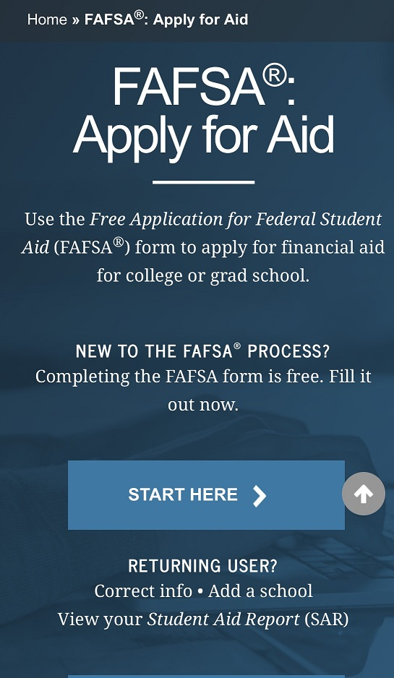
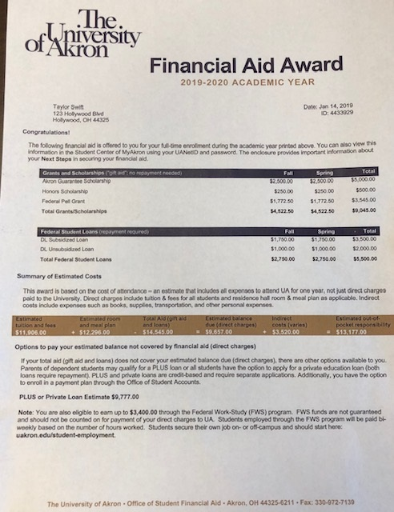
AGENDA
What is Financial Aid
The Process of Applying
Cost of Attendance
MyAkron & the Student Center
How to View and Accept Your Aid
NSLDS/Your Previous Aid
Next Steps
Other University Financial Resources

Slide 3
What is Financial Aid?
Financial Aid is a broad group of funding sources that assists students in meeting the cost of attending college and can include grants, scholarships, work-study programs, and student loans.

Slide 5
Cost of Attendance Examples
Graduate Students | Full Time 9 or more credits | 1/2 Time 4.5-8 credits | Less Than 1/2 Time 1-4 credits
Tuition and Fees | 16,884 | 8,898 | 4,194
Room and Board | 12,296 | 12,296 | 0
Books and Supplies | 1,000 | 500 | 250
Transportation | 1,600 | 1,600 | 0
Personal Expenses | 3,000 | 3,000 | 0
Total Ohio Resident | 34,780 | 26,294 | 4,444
Non Resident Charge | 9,788 | 4,894 | 2,448
Total Non-Ohio Resident | 44,568 | 31,188 | 6,892
*New students, starting in Summer 2019, Fall 2019, or Spring 2020
*Full-time enrollment is 9 or more credits
www.uakron.edu/finaid/cost-of-attendance

Slide 6
Types of Financial Aid
Gift Aid | Description
Grants | Awarded by federal and state government
Scholarships/Fellowships | Awarded by a variety of sources including the University, community groups, businesses, etc.
Self-Help Aid | Description
Student Employment/Federal Work Study | Money earned while working part-time on campus
Subsidized/Unsubsidized Loans (student) | Low interest loans, repaid by the student after graduation
Private Loans | Loans that students borrow (Might often needs a cosigner), repaid after graduation

Slide 7
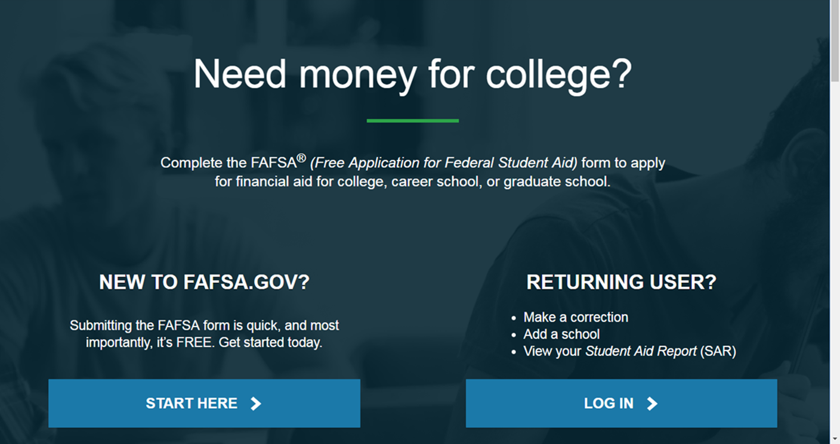
How do I apply for financial aid? www.fafsa.gov

Slide 8
Application Process Flow
Student completes FAFSA
UA receives results and determines if any additional information is needed and makes request
Student provides any additional information needed
Student receives Financial Aid Offer detailing financial aid awards including grants, scholarships, work-study, loans
UA reviews and finalizes awards

Slide 9
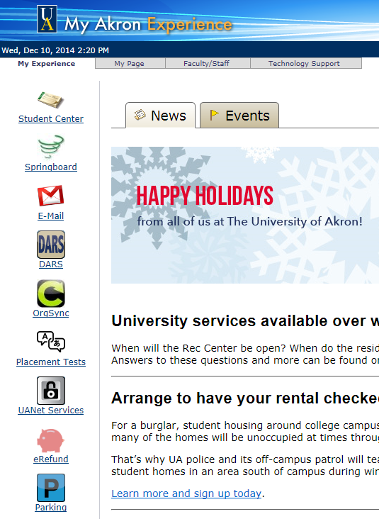
Check Your Email!
UA faculty members and offices on campus will communicate with you through your University email address.
It is important that you check your email at least once a day!

Slide 10
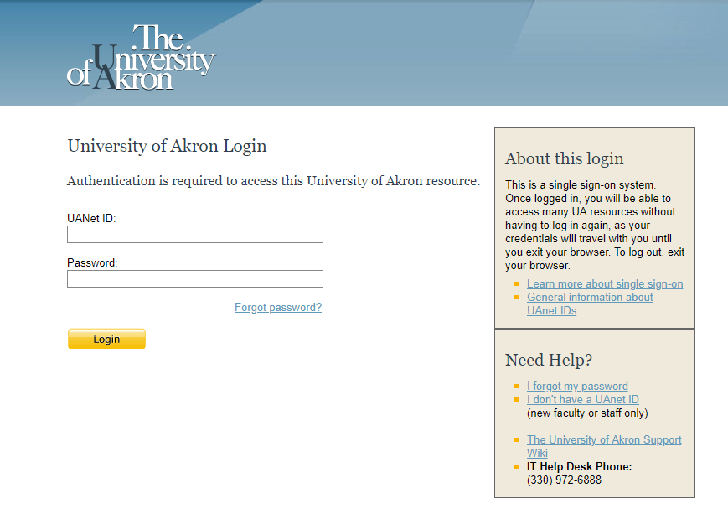
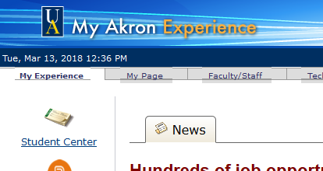
Student Center of MyAkron
https://my.uakron.edu
Students log in with the UANet ID and password (emailed from Admissions)

Slide 11
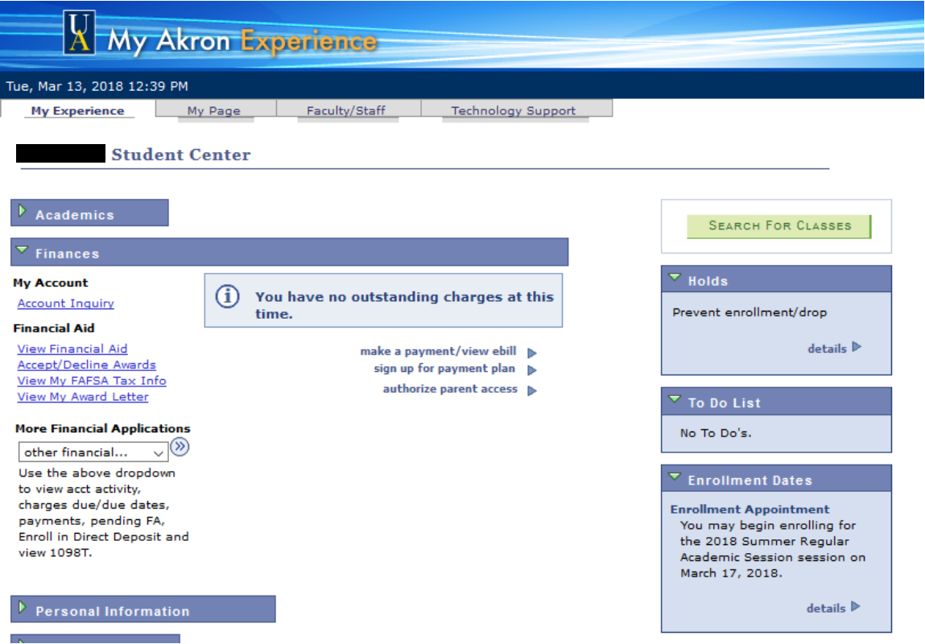
Notes:
*****Update to a 2020 person

Slide 12
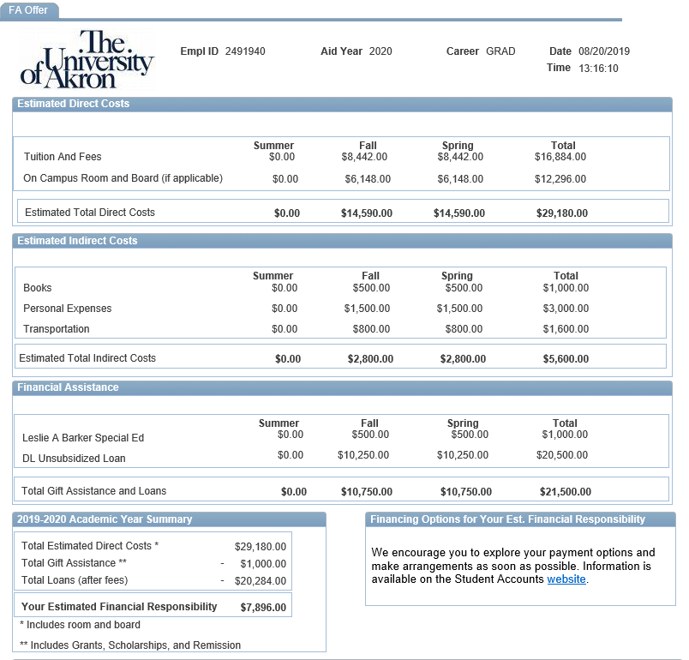

Slide 13
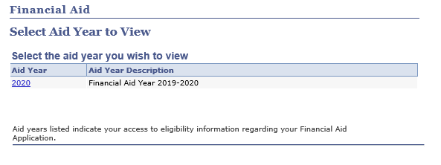
Notes:
Check for an award – maybe it just didn’t come in the mail.
**** update to a 2020 person

Slide 14
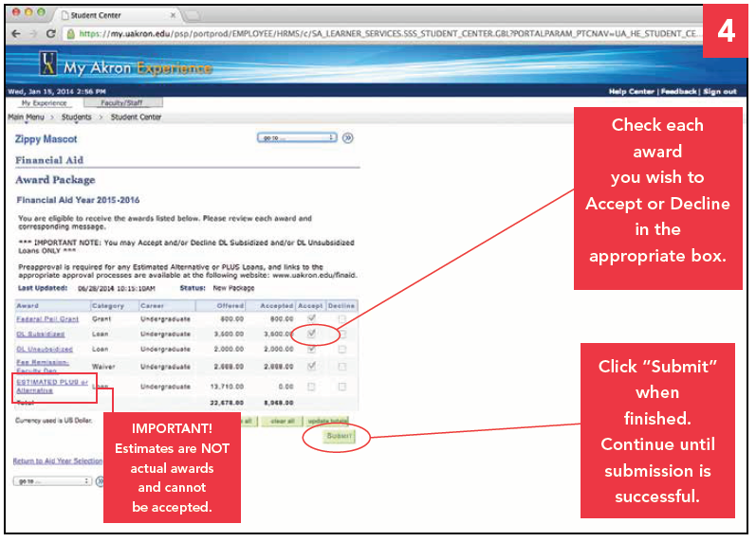
Accept/Decline Awards
Notes:
*****Update to a 2020 person

Slide 15
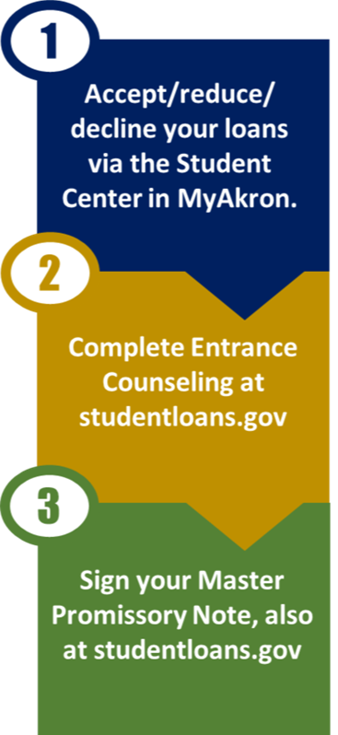
Loan Requirements
First-time student loan borrowers need to complete two requirements:
Entrance counseling
Master Promissory Note
Both of these can be completed online at studentloans.gov
Notes:
Note if you completed at a previous institution, no need to complete again. If your MPN has expired, we will contact you.

Slide 16
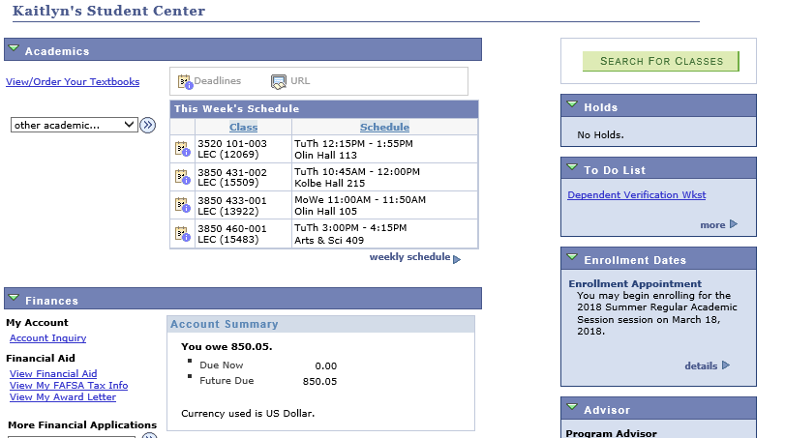
No award letter?
Notes:
Click on “more” to see the full list and details, including links/instructions.

Slide 17
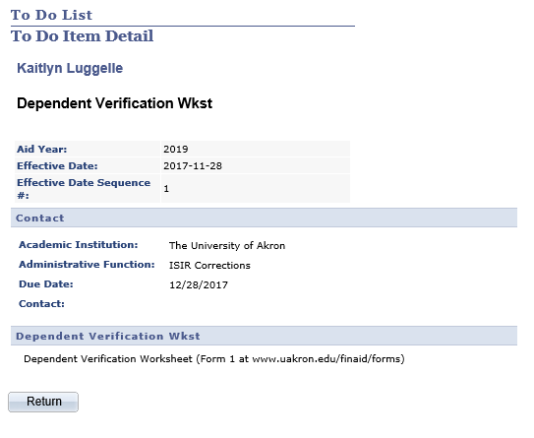
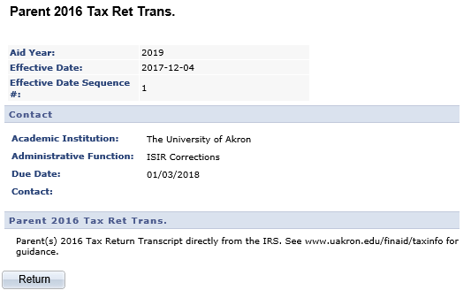
Notes:
Follow the link to either the UA form or guidance to obtain the documents we’ve requested.

Slide 18
Loan Considerations
Loan Limits (Annual and Aggregate)
Year | Dependent Undergraduates | Independent Undergraduates
First year (0-30 credits completed) | $5,500—No more than $3,500 in Subsidized loans | $9,500—No more than $3,500 in Subsidized loans
Second year (31-60 credits completed) | $6,500—No more than $4,500 in Subsidized loans. | $10,500—No more than $4,500 in Subsidized loans
Third Year + (completed 61 or more credits) | $7,500—No more than $5,500 in Subsidized loans | $12,500—No more than $5,500 in Subsidized loans
Aggregate Loan Limits | No more than $31,000 combined sub/unsub | No more than $57,500 combined sub/unsub
Grad/ Professional Students Loan Limits (Annual and Aggregate)
Masters or Doctorate program (MA, MBA,MD, JD, PhD, EdD) | Annual Limit $20,500 | No more than $138,500 combined sub/unsub (includes loans from undergraduate degree)

Slide 19
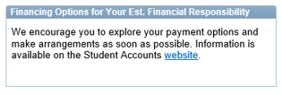
Financing Options
 | Private Loan | Payment Plan (Office of Student Accounts)
FAFSA Required? | No | No
Credit Check? | Yes – student (and cosigner) | NA
Rates | Varies by lender (based on credit history of applicant/ cosigner) | $35 application fee; 25% down payment
Application Process | uakron.edu/finaid/private | uakron.edu/paymentoptions
Private loans are disbursed directly to UA. Any overage creates a credit balance which will be refunded by the Office of Student Accounts (can be used for books, expenses, etc.).
Notes:
Emphasis on length of time needed for us to process loans in July/August/September

Slide 20
Loan Lender vs. Servicer
Your loan servicer:
Manages the repayment of your debt/collects repayments
Tracks due dates and minimums
Ensures you don’t slip into delinquency or default
If you need to change your repayment plan, work out a new payment schedule, ask for deferral or forbearance, or verify any loan forgiveness you may qualify for, contact your loan servicer.
It’s your servicer’s job to keep you in good standing by giving you the support and resources you need.
Source: https://studentloanhero.com/featured/student-loan-servicing-explained-difference/

Slide 21
www.nslds.ed.gov

Slide 22
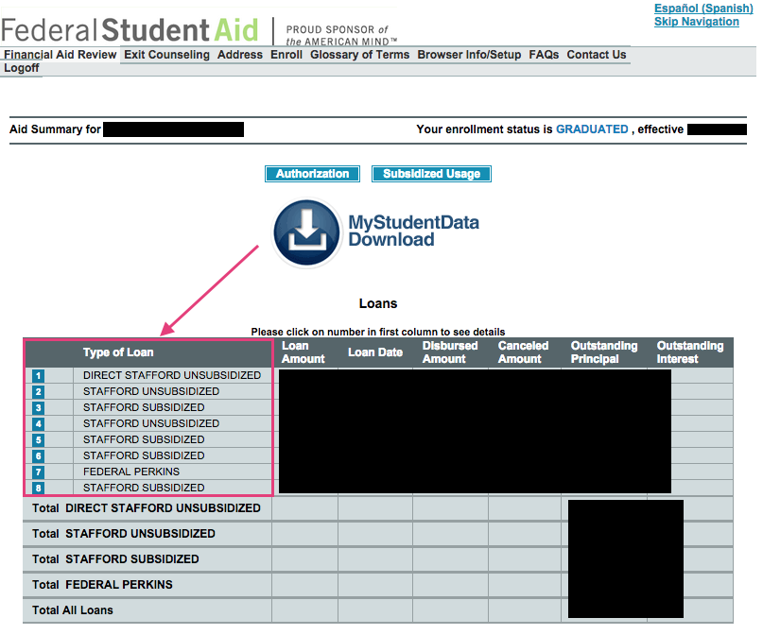
NSLDS
Select “Financial Aid Review”
Accept the terms/conditions & sign in with your FSA ID (username and password)
View Aid Summary
Source: https://www.nerdwallet.com/blog/loans/student-loans/who-is-my-loan-servicer/

Slide 23
Student Loan Servicer Info
Click numbers in blue boxes to bring up more details about each of your loans (including interest rate, outstanding balance, etc.)
The information in the “contact” box is your loan servicer

Slide 24
Student Loan Servicer Info
Check each of your loans for servicer information
You may not have the same servicer for all loans
Create an account at your servicer’s website

Slide 25
Federal Financial Aid History
The National Student Loan Data System (NSLDS) will include your financial aid history, including:
Federal grants (Pell, SEOG)
Federal student loans (subsidized/unsubsidized)
Federal Perkins Loans
Parent Loans (if you are the parent borrower)
Note NSLDS does not include private loans or institutional loans

Slide 26
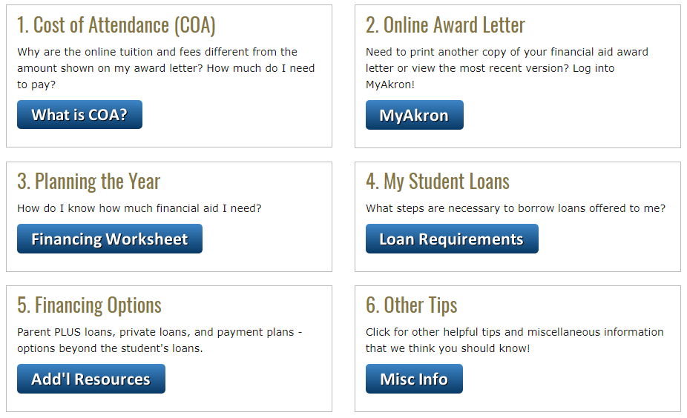
Your Next Steps - www.uakron.edu/finaid/next

Slide 27
Contact the Office of Student Financial Aid
Simmons Hall Room 202 330-972-7032
1-800-621-3847
Online at
uakron.edu/finaid/support
Live Chat
Available 24/7/365
Notes:
Emphasis on length of time needed for us to process loans in July/August/September

Slide 28
External Scholarship Sources
Financial Aid Scholarship Board
Private foundations
Businesses and employers
Civic and charitable organizations
Churches
Local libraries

Slide 29
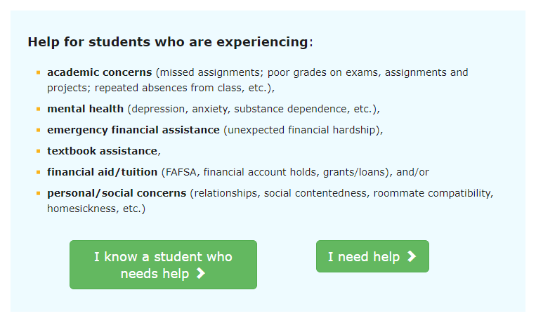
Help-A-Zip Referral
www.uakron.edu/referral
Notes:
Shows where students would submit a HAZ referral...What the form looks like.

Slide 30
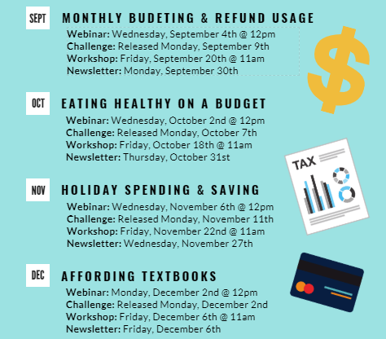
Balancing on a Budget

Slide 31
Financial Empowerment Center
FREE one-on-one financial counseling delivered by professionally trained coaches
Conveniently located in Simmons Hall
Appointment needed, can schedule via ZipAssist
Financial coaching focuses on these areas:
Credit score improvement
Debt reduction
Increased saving and asset building
Banking access
Notes:
This slide discusses the free financial coaching available in Simmons Hall. Students can register for an appointment at the ZipAssist website. He consistently is booked 3 weeks in advance, so encourage students to sign up quickly if they’re interested.

Slide 32
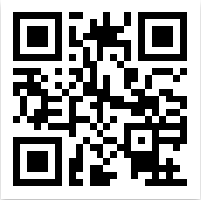
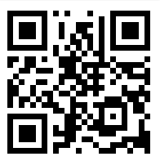
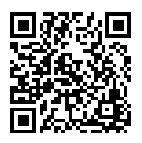
Connect with the Office of Student Financial Aid!
Tips, announcements, reminders, how-to videos & more!
facebook.com/UAFinAid
@AkronFinAid
University of Akron – Student Financial Aid
Notes:
Reminders, announcements about scholarships, etc. Use the QR code to go directly to the pages to like, follow, & subscribe!

Slide 33
Questions

